Slide 1
A Machine Learning Diagnostic Tool for Coronary Heart Disease
Heath Brinkman

Slide 2
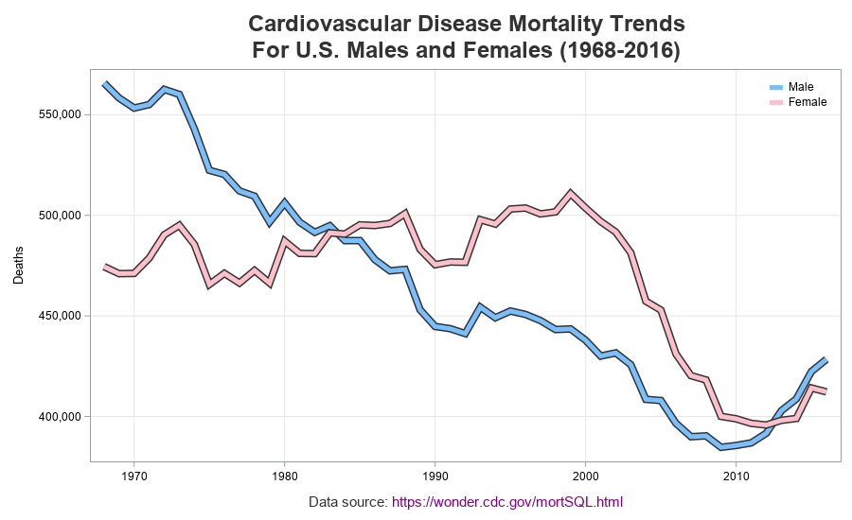
Background
Heart disease is the leading cause of death for men, women, and people of most racial and ethnic groups in the United States
Coronary heart disease is the most common type of heart disease, killing 365,914 people in 2017
Early diagnosis can help reduce mortality rates

Slide 3

Problems with diagnosis/why ML?
Accuracy/speed/consistency/cost of diagnosis
Limited access/comprehension
Case-by-case diagnosis/individual knowledge
Image sources: wikipedia.org, harvard.edu

Slide 4
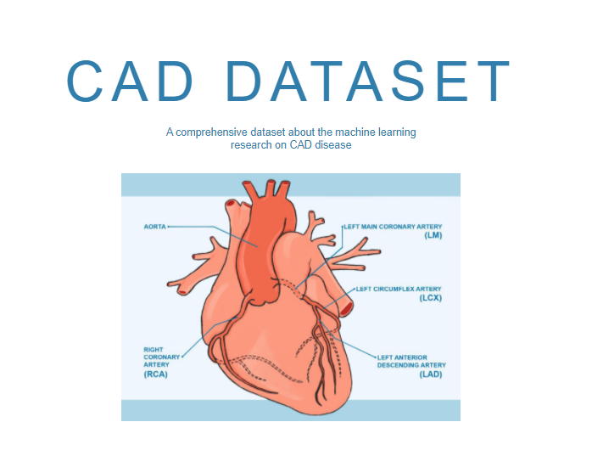
Dataset Background
Coronary artery disease (CAD) database
126 papers and 68 datasets
11 conserved features, 1190 entries between subset of 5 datasets
Extracted from scientific literature between 1992 and 2018
Data source: www.cadataset.com, https://www.nature.com/articles/s41597-019-0206-3

Slide 5
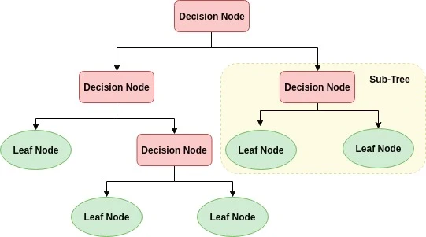
Model Selection Background
Decision Tree
Adaboost/Gradient Boosting to reduce error
Image source: wikipedia.org

Slide 6
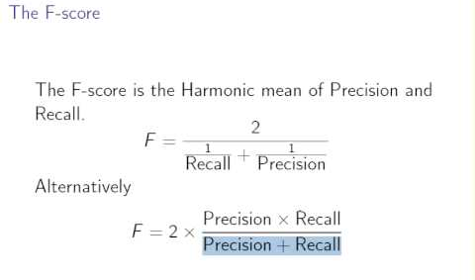
Model Selection
Minimize error
False positives/false negatives both have harmful outcomes
F1 is the harmonic mean of precision and recall
Image source: deepai.org

Slide 7
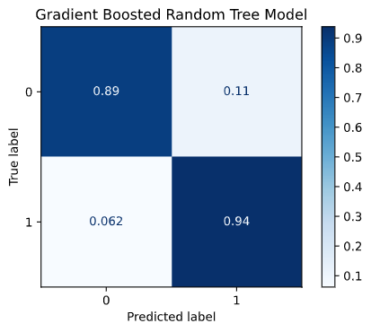
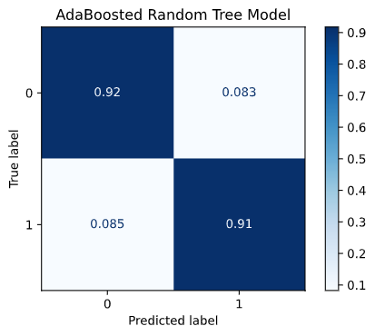
Model Performance

Slide 8
Model Performance
AdaBoost
F1 Score: 0.92
Overfitting Metric: 0.08
Gradient Boost
F1 Score: 0.92
Overfitting Metric: 0.07

Slide 9
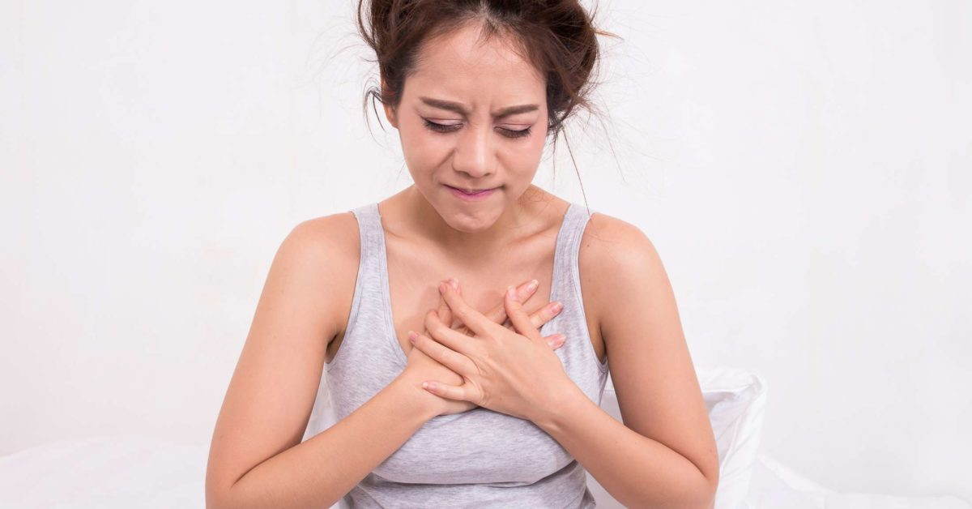

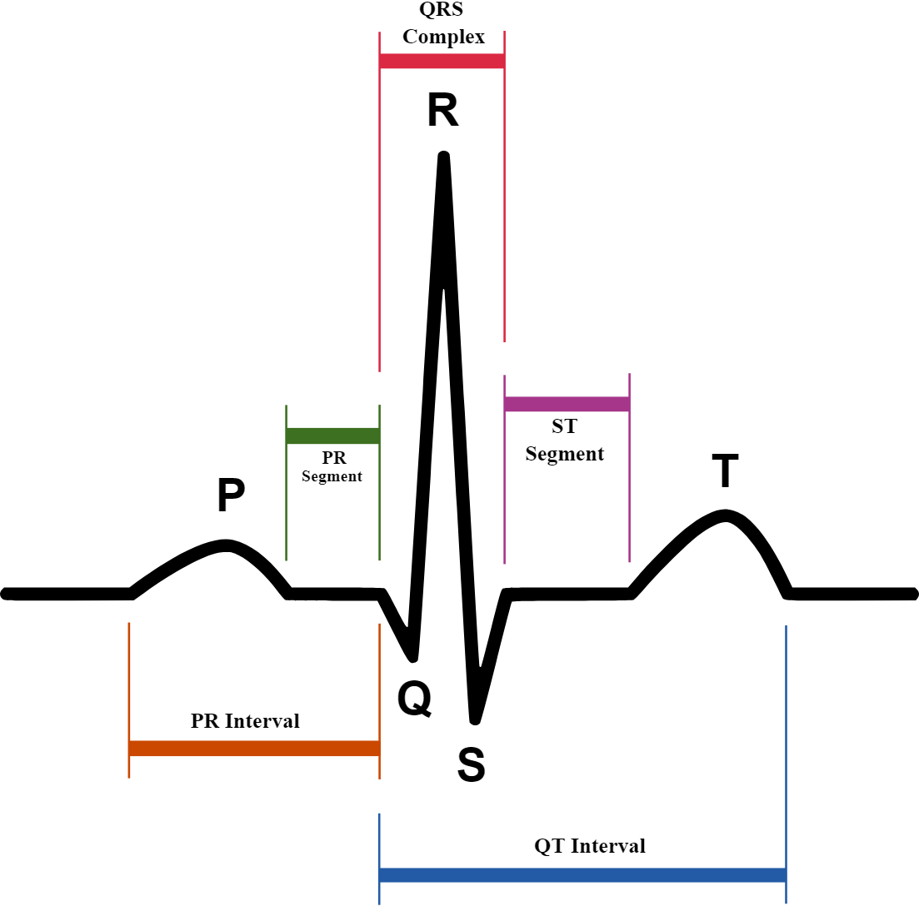
Model Implementation - Simulated Example
Age: 44
Female
No chest pain
Resting BP: 160/80
Serum Cholesterol: 283
High Fasting Blood Sugar
Normal Resting ECG
Maximum heart rate achieved: 190 BPM
Exercise Induced Chest Pain
Exercise induced ST-depression: 3.4
Upsloping ST Segment during peak exercise
The model predicts the patient has heart disease with a 52% probability. With a model F1 score of 0.92, the physician or technician could recommend medical treatment or lifestyle changes

Slide 10
Model Limitations
High F1 score and low overfitting is an indicator of a good model
However, does not take into all factors that can lead to heart disease
Only applies to data with the given variables
Pushback from diagnostic personnel

Slide 11
Next Steps
Additional studies that capture the same variables could help expand the dataset used to train the model
New studies designed with the goal of collecting data useful for ML diagnostic tools
Implementation of the created model in medical field to assist doctors in diagnosis as well as allow for untrained medical workers to find likely health outcomes
Implementation of model creation methodology for other pathologies.

Slide 12
Questions?

